Slide 1
Horses for Courses
A story of improvement from LV=
June 2016

Slide 2
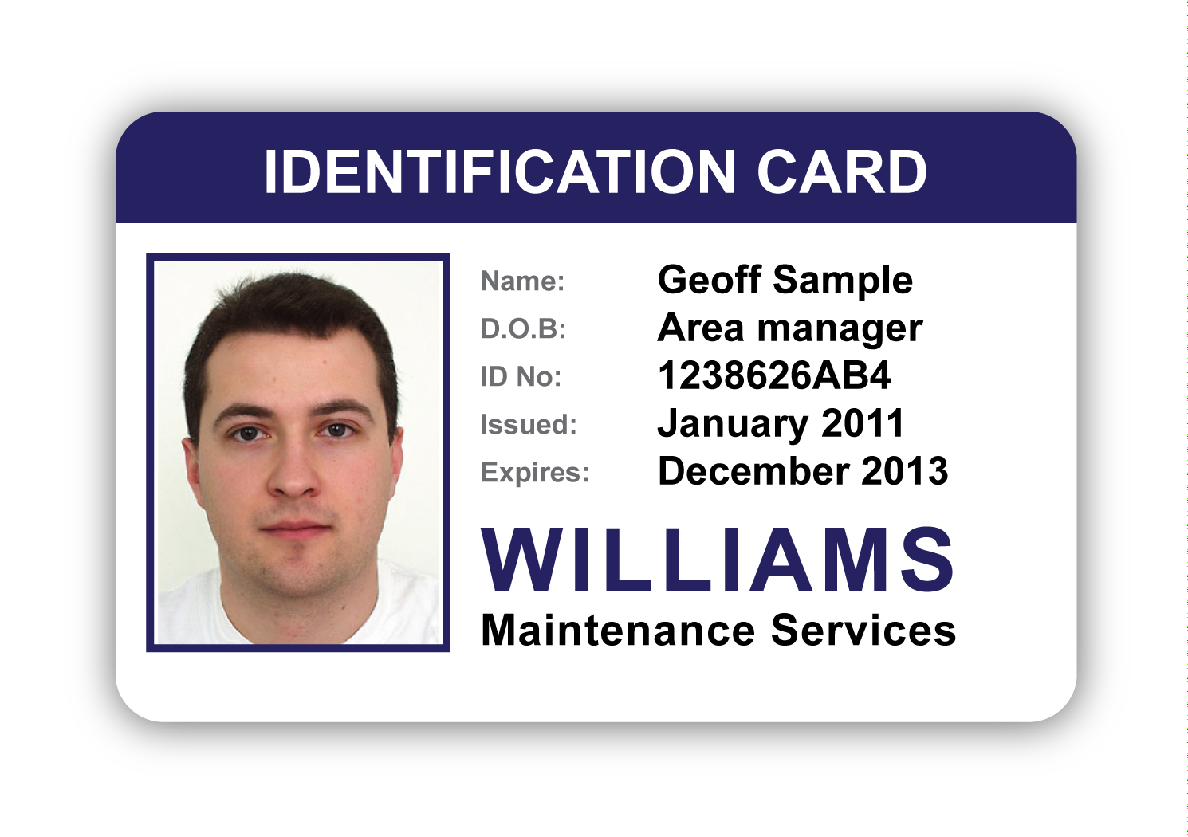
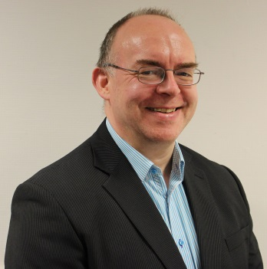
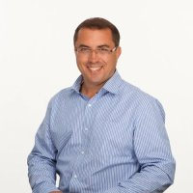
Presenters
A Bit About Us
30 yrs in IT covering ops, dev, design and management.
Joined LV= 7 yrs ago as a dev manager, moved to our CTO team 2 yrs ago as an Automation and Delivery Lead driving out the practices across LV=.
Often found working as the glue between technical Dev and Ops teams
Numerous years in IT in roles ranging from hardware engineer through UNIX & Oracle Admin and into leading technical teams within the utilities and insurance markets
Joined LV= just over 4 yrs ago to head up Dev Services. Now within our CTO team developing our solution architecture community.
Often found working in a bridging role – most recently between Dev and Ops

Slide 3

LV=
Who are we?
You may know us as Liverpool Victoria but we changed to LV= in 2007
Liverpool Victoria Friendly Society was founded in 1843 as a burial society
Today LV= provides insurance, investment and retirement solutions with a vision to be Britain's best loved Insurer
Third largest car insurer in the UK
Over 5.7 million customers
Top provider of individual income protection in the advised market and a leading provider of enhanced annuities
Over 6,000 employees working in 16 offices
We offer our products and services direct, as well as through advisers and brokers, and through strategic partnerships

Slide 4
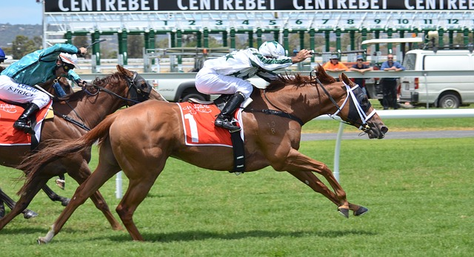
So Why ‘Horses for Courses’?
Need The Right Horse
People are suited to different situations
However, people can adapt and embrace change
The pace of change is accelerating
Fitness and discipline will be key
From cart horse to race horse, amazing transformations are taking place

Slide 5


Drivers for change?
A view from our stakeholders in 2012
John O’Roarke (Jan 2012): ‘We’ve achieved tremendous growth in sales and profitability over the last five years and that simply wouldn’t have been possible without your enthusiastic support and commitment. Looking forwards, we still see significant opportunities to make this business bigger and stronger – but our competitors will be thinking exactly the same thing. To beat them we’ll have to be ‘faster to market’ and more cost-efficient across all aspects of our business. That’s why the plan for transforming Solution Delivery has the full support of the GI Exec team.’
Richard Rowney (Jan 2012): ‘Our Life business has continued to out perform it's competitors in recent years and, despite the challenging market conditions, we have created a "growth" business in a stagnant sector. Our challenge is to remain ahead of the competition, investing in propositions that will differentiate us and allow us to generate superior returns. At the heart of this will be our ability to manage a number of competing tensions, namely:
- Remaining agile, yet working within the overall IT roadmap
- Executing quickly yet safely
- Investing in innovation whilst keeping BAU costs below those of our competitors.
To deliver these requires us to reshape and refocus our Solution Delivery capability. The team have laid good foundations and the Life business looks forward to building on these in the months and years ahead.

Slide 6

The Vision
Key Metrics of Change
Deliver twice the volume of change with zero change-related defects
Throughput
Quality

Slide 7




The Challenges
What Wasn’t Working So Well
Legacy
Too Many Tools
Scepticism
Engagement
Highly Complex
-----------------
Slow To Change -----------------
High Cost Of Development
Duplication
-----------------
Hard To Consolidate -----------------
Silos Of Functionality
Feels Too Difficult
-----------------
Regression -----------------
Lack Of Knowledge
Lack Of Buy-In
-----------------
Protectionism -----------------
Poor Communication

Slide 8



The Journey So Far
From Introducing CI & The Build Team To Mobilising Automation
LV= IT
LV= IT
IT Change
Dept.
IT Run
Dept.
IT Change
Dept.
IT Run
Dept.
Dev & Tech
Teams
Build
Teams
Operations
Teams
Dev & Tech
Teams
Build
Teams
Operations
Teams
Initial Automation Platform
Current Automation Platform
Where We Started
Where We Are Now

Slide 9
What we used to support the journey
Evolving our technical layers
Version Control GIT
Continuous Integration Jenkins
Static Code Analysis Sonar
Infra as Code Puppet
Collaboration Confluence
Task Management JIRA
Start with the core technologies so we could control the What, Why, How, When and Where
Binary Repository Nexus
Testing Selenium
Logging Splunk
Orchestration T.b.d
Extend the coverage to object management, test automation and log aggregation
Containerisation Docker trial
Security testing T.b.d
Enhance and extend the capabilities

Slide 10
Database Provisioning
Database provisioning with and without Delphix.
5 days – multiple teams, multiple hand-offs
Typical DB Build
Half a day – 1 team, 1 hand-off
Current Delphix Build
Self Service
Next Step - Delphix Build

Slide 11
METRICS
What the numbers are telling us
Decrease in resource needs for releases with deployment times reduced by up to 85%
Development build has moved from an onerous manual task to something that just happens
Quality has increased – in some cases weeks have been cut off of test/fix cycles
Static code analysis is helping reduce security issues and costs.
Weblogic server builds – down from 3hrs manual work to 20mins config driven creation
Currently <1% production and <2% non-prod Rollback or Fix forward releases
Time to market for some products has decreased – previous quarterly releases now happen fortnightly with some even deploying weekly.
We haven’t quite made the “Twice the volume”, but 1.6 times the release volume is a good leap forwards

Slide 12
Culture and Behaviour
Key changes
The initial “push” is slowly turning into a “pull”
Teams and projects are actively adopting the practices and helping drive behavioural changes
Some teams have reorganised as feature teams bridging across previously siloed areas
Collaboration across teams has improved
Ideas are flowing around what we could do next

Slide 13
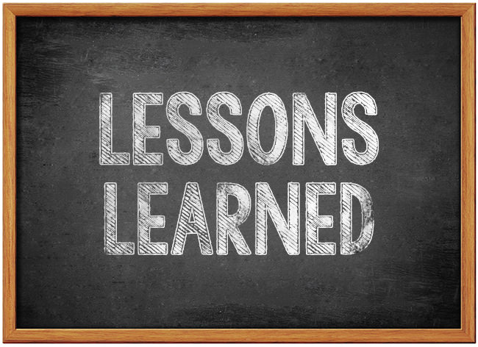
So What Went Well?
Our Key Learnings
Seeding the right skills-sets with the right behaviours – in building the team we focused on problem solvers
We created cross-functional teaming
We created broader enthusiasm and engagement through internal DevOps and Open Space gatherings
Use of tooling was not mandated
We helped up-lift our development practice introducing improved code management and versioning
We knocked weeks off of some plans through Continuous Integration practices
Large programmes leveraged the tooling to help improve x-team decision making
Our ITIL focused service teams maintained a mantra of adopt and adapt.

Slide 14
Benefits
More Releases, Less Incidents
More Than 50 Days without a P1!!

Slide 15
In Summary
Onwards and Upwards!
Problems are an opportunity
We are still learning
There is a increasing awareness at all levels within the organisation of what can be achieved through more collaborative, iterative working practices
We are fundamentally an ITIL shop and continue to evolve and maintain a positive improvement trend through adoption of sound engineering practices
Our Operations and Application Support teams are now leading on automation initiatives
The role of the architect will become more important as we design for pace and agility across the enterprise
This r/evolution is exciting; why…. because its making a real difference to the way we do IT

Slide 16


